Slide 1

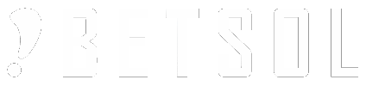
Container Storage & Networking
Container Enablement Workshop

Slide 2
Container Storage & Networking
Storage with Docker
Storage with Kubernetes
Container Network Model
Networking with Docker
Networking with Kubernetes

Slide 3
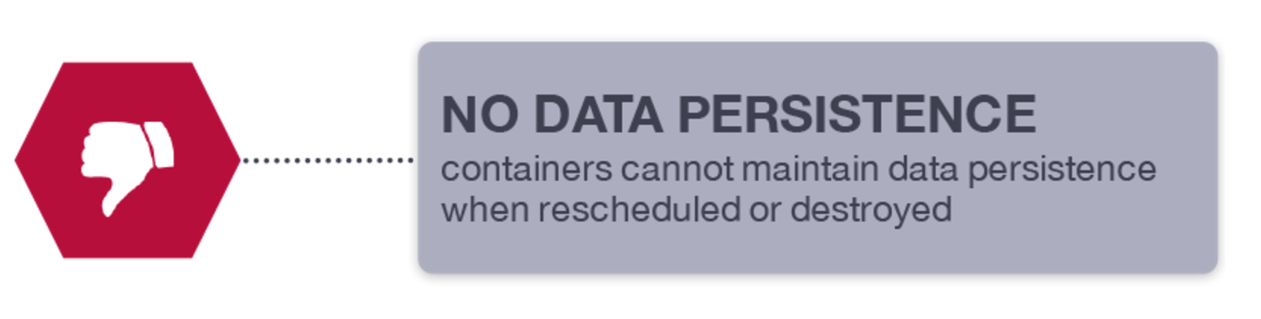
Storage with Docker
Docker Containers are ephemeral by design. They were designed for stateless applications, offers high availability and portability, but is not so great for preserving the data.
It is possible to store data within the writable layer of a container, but there are some downsides:
The data won’t persist when that container is no longer running, and it can be difficult to get the data out of the container if another process needs it.
A container’s writable layer is tightly coupled to the host machine where the container is running. You can’t easily move the data somewhere else.
Notes:
Move this goal to module 2

Slide 4
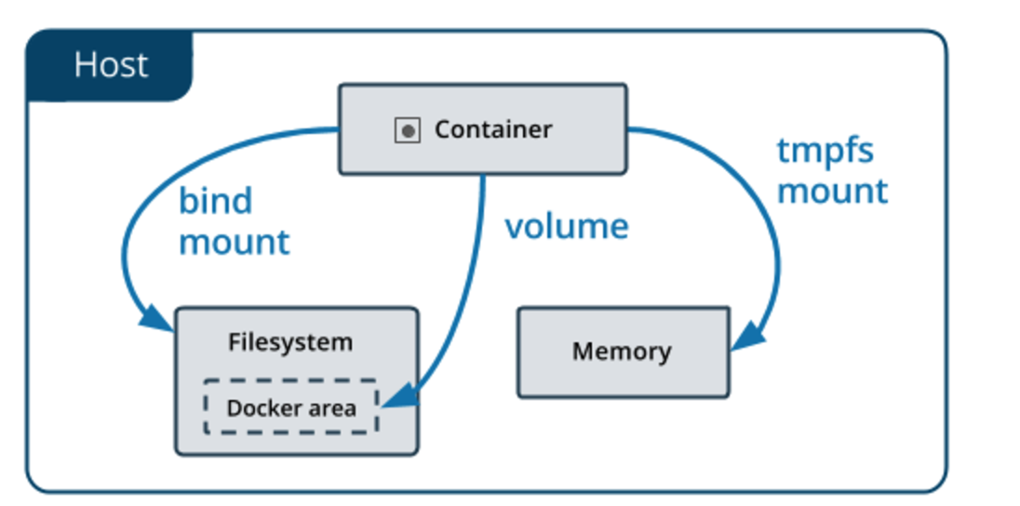
Storage with Docker
Docker offers three different ways to mount data into a container from the Docker host:
docker volumes
bind mounts
tmpfs volumes
No matter which type of mount you choose to use, the data looks the same from within the container. It is exposed as either a directory or an individual file in the container’s filesystem.
An easy way to visualize the difference among volumes, bind mounts, and tmpfs mounts is to think about where the data lives on the Docker host.
Notes:
Move this goal to module 2

Slide 5
Storage with Docker
Volumes are stored in a part of the host filesystem which is managed by Docker (/var/lib/docker/volumes/ on Linux). Non-Docker processes should not modify this part of the filesystem. Volumes are the best way to persist data in Docker.
Bind mounts may be stored anywhere on the host system. They may even be important system files or directories. Non-Docker processes on the Docker host or a Docker container can modify them at any time.
tmpfs mounts are stored in the host system’s memory only, and are never written to the host system’s filesystem.
Notes:
https://docs.docker.com/engine/admin/volumes/
https://thenewstack.io/methods-dealing-container-storage/

Slide 6
Storage with Docker
Data volumes and the storage driver
When a container is deleted, any data written to the container that is not stored in a data volume is deleted along with the container.
A data volume is a directory or file in the Docker host’s filesystem that is mounted directly into a container.
Data volumes are not controlled by the storage driver.
Reads and writes to data volumes bypass the storage driver and operate at native host speeds.
You can mount any number of data volumes into a container.
Multiple containers can also share one or more data volumes.
Notes:
https://docs.docker.com/engine/admin/volumes/
https://thenewstack.io/methods-dealing-container-storage/

Slide 7
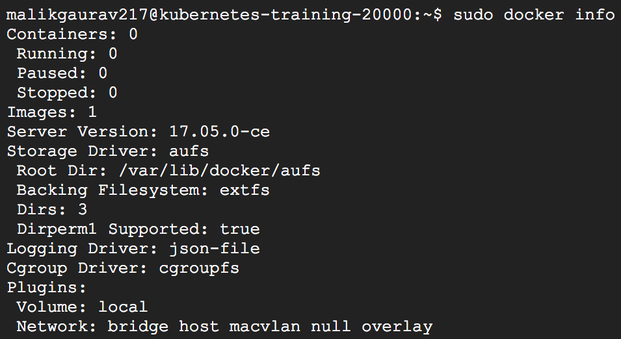
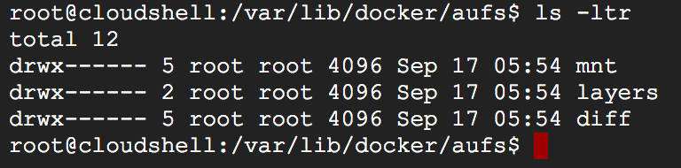
Storage with Docker
By default, Docker ships with a AUFS storage driver.
The storage driver controls how images and containers are stored and managed on your Docker host.
you can use the --storage-driver flag when starting the Docker daemon manually, or (recommended) set the option in the daemon.json file, which is located in /etc/docker/
{ "storage-driver": "devicemapper" }
Notes:
https://docs.docker.com/engine/admin/volumes/
https://thenewstack.io/methods-dealing-container-storage/

Slide 8
Storage with Docker
Which driver to use?
If aufs is available, default to it, because it is the oldest storage driver. However, it is not universally available.
If possible, the storage driver with the least amount of configuration is used, such as btrfs or zfs.
Otherwise, try to use the storage driver with the best overall performance and stability
overlay2 is preferred, followed by overlay. Neither of these requires extra configuration.
devicemapper
Order : aufs","btrfs","zfs","overlay2","overlay","devicemapper","vfs”
https://github.com/moby/moby/blob/17.05.x/daemon/graphdriver/driver_linux.go
Factors
Docker edition, operating system, and distribution.
to use a specific format for the backing filesystem
characteristics of your workload and the level of stability

Slide 9
Storage with Docker
AUFS is a union filesystem, which means that it layers multiple directories on a single Linux host and presents them as a single directory.
All of the information about the image and container layers is stored in subdirectories of /var/lib/docker/aufs/.
diff/: the contents of each layer, each stored in a separate subdirectory
layers/: metadata about how image layers are stacked. This directory contains one file for each image or container layer on the Docker host. Each file contains the IDs of all the layers below it in the stack (its parents).
mnt/: Mount points, one per image or container layer, which are used to assemble and mount the unified filesystem for a container. For images, which are read-only, these directories will always be empty.
Notes:
https://docs.docker.com/engine/admin/volumes/
https://thenewstack.io/methods-dealing-container-storage/

Slide 10
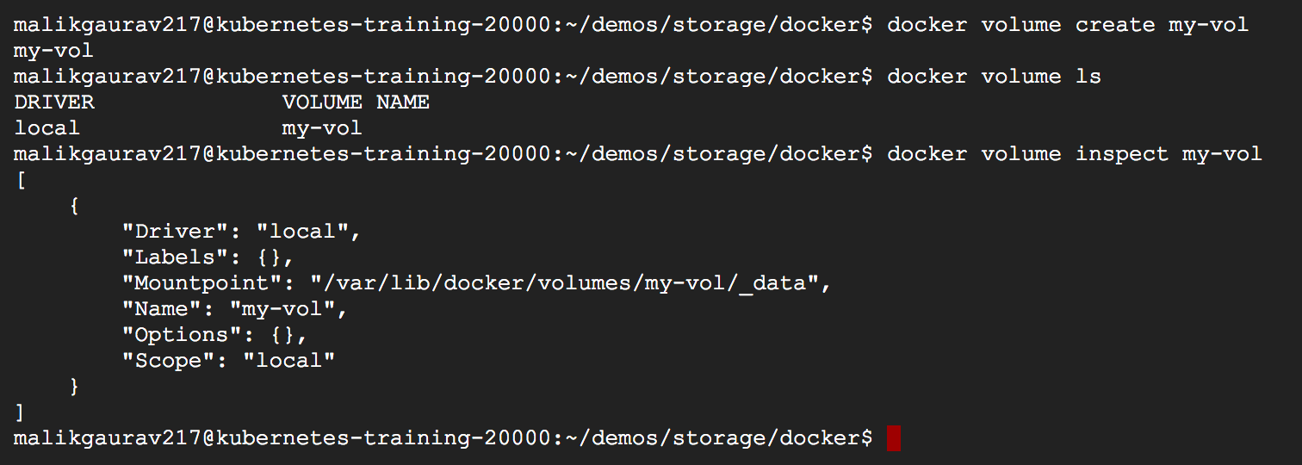
Storage with Docker
Create and manage volumes
Create docker volume
$docker volume create my-vol
inspect docker volume
$docker volume inspect my-vol
Notes:
https://docs.docker.com/engine/admin/volumes/
https://thenewstack.io/methods-dealing-container-storage/

Slide 11
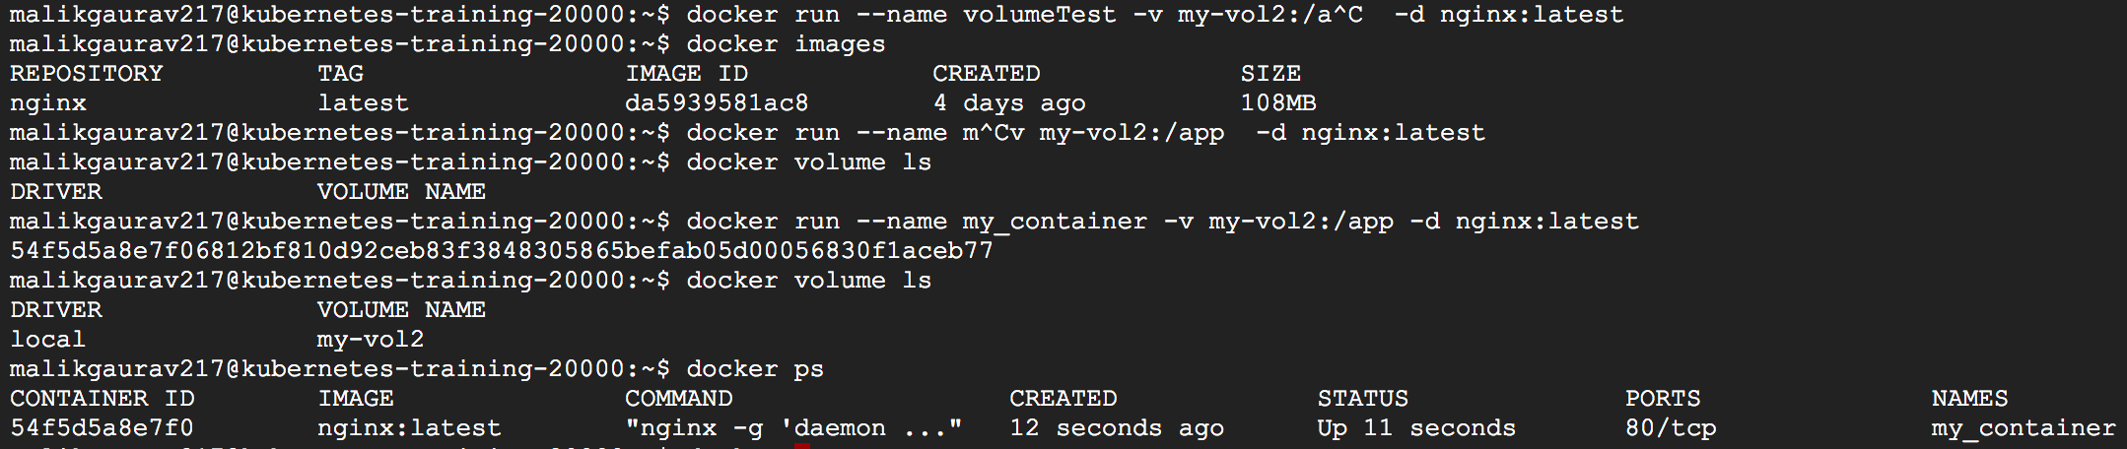
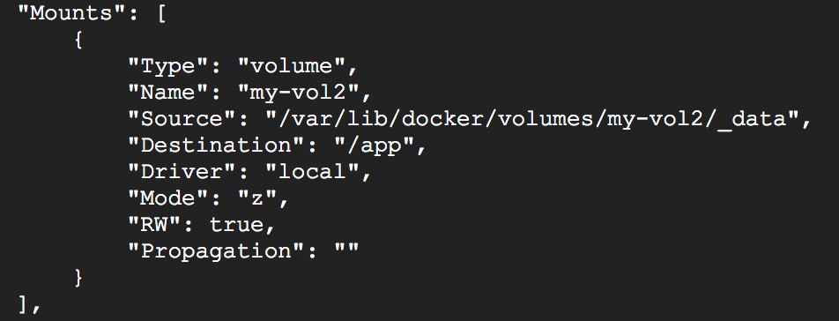
Storage with Docker
Start a container with a volume
Docker creates the volume if it doesn’t exist when we run a container
$docker run --name volumeTest -v my-vol2:/app -d nginx:latest
$docker inspect volumeTest
Look for the Mounts section:
Notes:
https://docs.docker.com/engine/admin/volumes/
https://thenewstack.io/methods-dealing-container-storage/

Slide 12
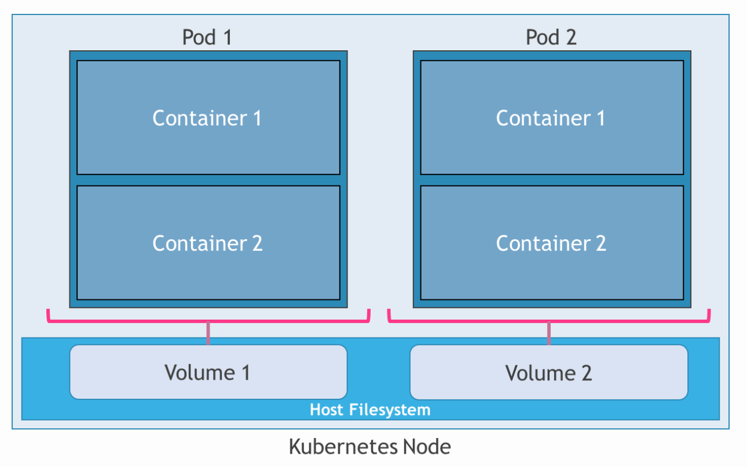
Storage with Kubernetes
When it comes to persistence in Kubernetes, users should get familiar with the concepts of volumes, persistent volumes, persistent volume claims (PVC) and the upcoming Pet Sets.
Volumes
Kubernetes volumes are similar to Docker volumes. Both are designed to bring a level of persistence to containers by relying on the underlying host.
Unlike Docker volumes that are influenced by a specific container, Kubernetes volumes are tied to the lifecycle of a pod. Even if the containers running within a pod get terminated or restarted, the associated volume will continue to exist. It will only get deleted when the pod is explicitly terminated.
Notes:
https://thenewstack.io/strategies-running-stateful-applications-kubernetes-volumes/

Slide 13
Storage with Kubernetes
Kubernetes volumes may be classified
Host-based storage
Non-Host-based storage.
Host-based storage is similar to Docker volumes, where a portion of the host’s storage becomes available to the pod. Once a pod is terminated, the volume gets automatically deleted.
Non-host-based storage doesn’t rely on a specific node. Instead, a storage volume is created from an external storage service. Volumes based on this storage type would be available even after the pods are deleted.
A variety of block storages, distributed filesystems and hosted filesystems — including Amazon EBS, GCE PD, Ceph, Gluster, NFS, Azure File System, Flocker and vSphere volumes — are supported.
Notes:
https://thenewstack.io/strategies-running-stateful-applications-kubernetes-volumes/

Slide 14
Storage with Kubernetes
A variety of volume types
Host Based – EmptyDir, HostPath
block storages - Amazon EBS, GCE PD, Ceph, Gluster, NFS, Azure File System and vSphere volumes …
distributed filesystems – NFS, Ceph, Gluster…
Other filesystems —Flocker and GitRepo
Persistence in PODs
PODS are ephemeral and stateless
Volumes persistence to pods
All containers in POD can access volumes
Volumes are associated with the lifecycle of pods
Directories in the host are exposed as volumes
Volumes may be based on variety storage backends
Notes:
https://thenewstack.io/strategies-running-stateful-applications-kubernetes-volumes/

Slide 15
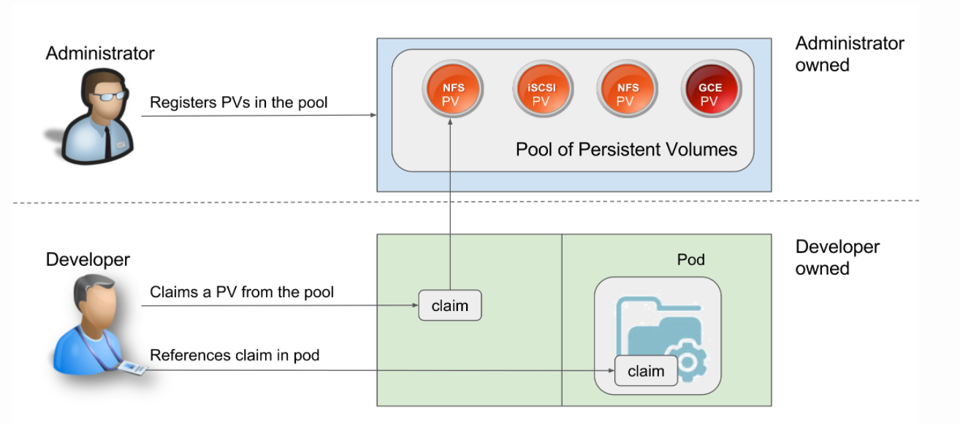
Storage with Kubernetes
Developers “ask” for the resources they need to run their applications through a declarative mechanism, typically described in YAML or JSON.
The Kubernetes master is responsible for ensuring that the appropriate resources are selected as requested by the developers.
But before it can do that, the administrators will need to provision the required compute, storage, and networking capacity. Unlike volumes, persistent volumes are not associated with any specific pod or containers when they are created. They are pre-provisioned storage resources that can be used by developers during the creation of a pod. Once persistence volumes (PersistentVolume) are provisioned by administrators, developers create a claim (PersistentVolumeClaim) to start consuming the storage resources exposed as persistent volumes.
Notes:
https://thenewstack.io/strategies-running-stateful-applications-kubernetes-persistent-volumes-claims/

Slide 16
Storage with Kubernetes
Kubernetes Volume
VS
Persistent Volume
In persistent volumes and claims, there is a strict enforcement of resource utilization dictated by the policy defined during the creation of resources.
Developers don’t expect a storage resource to be pre-provisioned before using volumes
Volumes can use implicit host-based storage or can explicitly request for persistence backed by external block storage devices and distributed file systems.
Volumes are similar to docker volumes in which container request for persistence at runtime, which is provided by the host.
Notes:
https://thenewstack.io/strategies-running-stateful-applications-kubernetes-persistent-volumes-claims/

Slide 17
Container Network Model
Why we need Container Networking?
Container network model (CNM)
Container network interface (CNI)
Containers need to talk to external world.
Reach Containers from external world to use the service that Containers provides.
Allows Containers to talk to host machine.
Inter-container connectivity in same host and across hosts.
Discover services provided by containers automatically.
Load balance traffic between different containers in a service
Provide secure multi-tenant services
There are two proposed standards for configuring network interfaces for Linux containers
Container network model (CNM)
Container network interface (CNI)
Notes:
Move this goal to module 2

Slide 18
Container Network Model
Container network model (CNM)
Specifications proposed by Docker adopted by projects such as libnetwork.
Supports only Docker runtime
Commonalities
CNI and CNM models are both driver-based – provide “freedom of selection” for a specific type of container networking
Multiple Network drivers can be active and used concurrently
Container network interface (CNI)
Specifications proposed by CoreOS and adopted by projects such as kubernetes, Cloud Foundry and Apache Mesos
Supports any container runtime
Containers are allowed to join one or more networks
Container runtime can launch network in its own namespace – delegate to the network driver the responsibility of connecting the container to the network
Keep networking as a library separate from the Container runtime
Networking implementation will be done as a plugin implemented by drivers.
IP address assignment for the Containers is done using local IPAM drivers and plugins.
Supported remote drivers are Weave, Calico, Contiv etc.
Supported local drivers are bridge, overlay, macvlan, ipvlan
The CNI interface calls the API of the CNI plugin to set up Container networking
The CNI plugin calls the IPAM plugin to set up the IP address for the container.
Available CNI plugins are Bridge, macvlan, ipvlan, and ptp. Available IPAM plugins are host-local and DHCP
External CNI plugins examples – Flannel, Weave, Contiv etc
Notes:
Move this goal to module 2

Slide 19
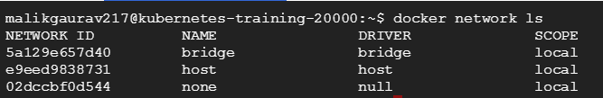
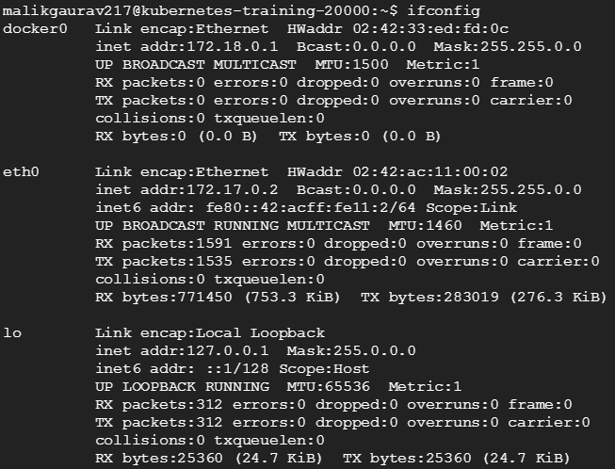
Container Network Model
When you install Docker, it creates three networks automatically:
By default docker create a new network interface called docker0 and every container that runs in this network is free to reach each others.
Command to inspect bridge network
$ docker network inspect bridge
It creates a default iptables NAT rule to allow outside communication between all containers connected to docker0 and the outside world.
$ sudo iptables -L –n
The best way to manage connections and traffic between our containers is with networks.
Notes:
Move this goal to module 2

Slide 20
Networking with Docker
Docker Native Network Drivers
The Docker native network drivers are part of Docker Engine and don't require any extra modules.
They are invoked and used through standard docker network commands.
Host
a container uses the networking stack of the host.
Bridge
creates a Linux bridge on the host that is managed by Docker
By default containers on a bridge can communicate with each other
Overlay
creates an overlay network that supports multi-host networks out of the box
The none driver gives a container its own networking stack and network namespace
MACVLAN
uses the MACVLAN bridge mode to establish a connection between container interfaces and a parent host interface.
None
It uses a combination of local Linux bridges and VXLAN to overlay container-to-container communications over physical network infrastructure
There is no namespace separation, and all interfaces on the host can be used directly by the container
It can be used to provide IP addresses to containers that are routable on the physical network
Without additional configuration, the container is completely isolated from the host networking stack
Notes:
Move this goal to module 2

Slide 21
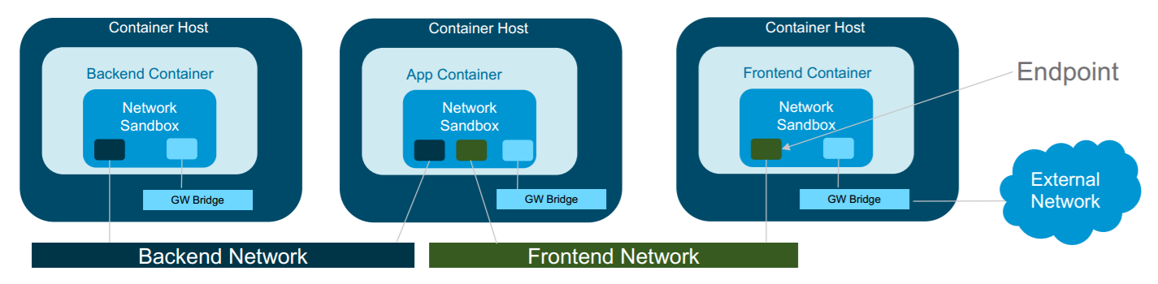
Networking with Docker
Container Network Model
Sandbox – A Sandbox contains the configuration of a container's network stack. This includes management of the container's interfaces, routing table and DNS settings. An implementation of a Sandbox could be a Linux Network Namespace or other similar concept.
Endpoint – An Endpoint joins a Sandbox to a Network. An implementation of an Endpoint could be a veth pair, an Open vSwitch internal port or similar.
Network – A Network is a group of Endpoints that are able to communicate with each-other directly. An implementation of a Network could be a VXLAN Segment, a Linux bridge, a VLAN, etc.
The CNM provides the following contract between networks and containers.
All containers on the same network can communicate freely with each other.
Multiple networks are the way to segment traffic between containers and should be supported by all drivers.
Multiple endpoints per container are the way to join a container to multiple networks.
An endpoint is added to a network sandbox to provide it with network connectivity.
Notes:
Move this goal to module 2

Slide 22
Networking with Docker
Docker libnetwork - Container Network Model (CNM)
https://github.com/docker/libnetwork
Libnetwork includes the following driver packages:
Null - The null driver is a noop implementation of the driver API, used only in cases where no networking is desired. This is to provide backward compatibility to the Docker's --net=none option.
Bridge - The bridge driver provides a Linux-specific bridging implementation based on the Linux Bridge. It creates a single bridge, called docker0 by default, and attaches a veth pair between the bridge and every endpoint.
Overlay - The overlay driver implements networking that can span multiple hosts using overlay network encapsulations such as VXLAN.
Remote - The remote package does not provide a driver, but provides a means of supporting drivers over a remote transport. This allows a driver to be written in a language of your choice.
Notes:
Move this goal to module 2

Slide 23
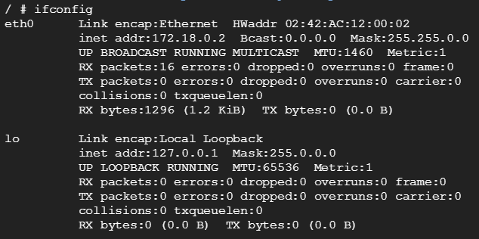
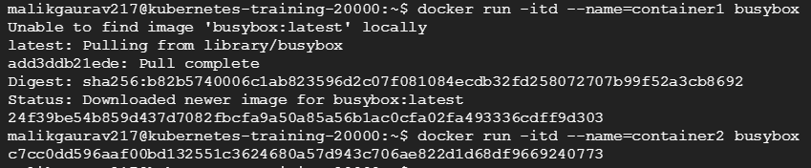
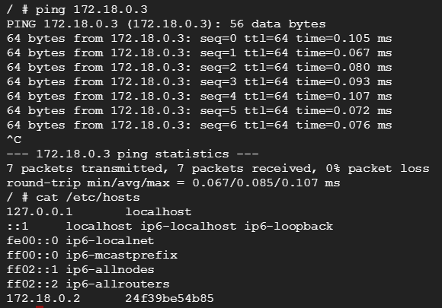
Networking with Docker
# Run busybox container1
docker run -itd --name=container1 busybox
# Run busybox container2
docker run -itd --name=container2 busybox
# attach container1
docker attach container1
Docker provides default network drivers for creating these networks
You can create as many networks as you need
you can connect a container to zero or more of these networks
you can connect and disconnect running containers from networks without restarting the container
When a container is connected to multiple networks, its external connectivity is provided via the first non-internal network
Notes:
Move this goal to module 2

Slide 24
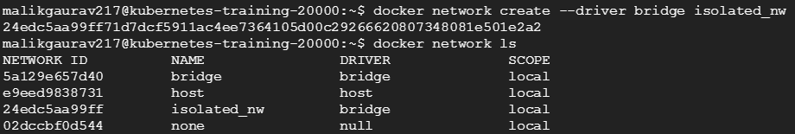
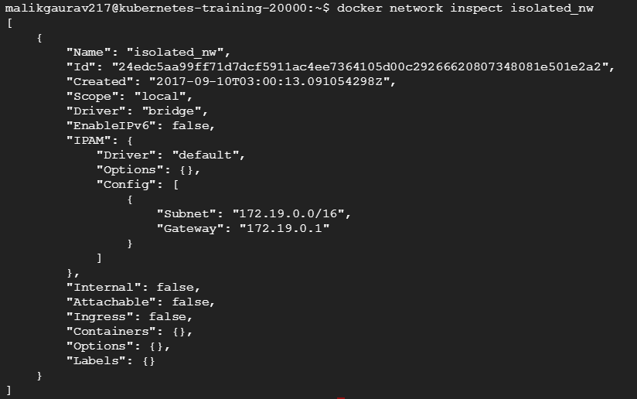
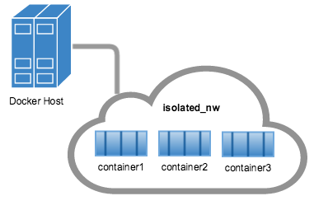
Networking with Docker
# create user defined bridge network
docker network create --driver bridge isolated_nw
# Run busybox container3
docker run -itd --name=container3 busybox
Notes:
Move this goal to module 2

Slide 25
Networking with Kubernetes
Container Network Interface (CNI)
CNI concerns itself only with network connectivity of containers and removing allocated resources when the container is deleted
Kubernetes uses the Container Network Interface (CNI) specification and plug-ins to orchestrate networking
Very differently from CNM, CNI is capable of addressing other containers’ IP addresses without resorting to network address translation (NAT)
Every time a POD is initialized or removed, the default CNI plug-in is called with the default configuration
This CNI plug-in creates a pseudo interface, attaches it to the relevant underlay network, sets IP Address / Routes and maps it to the POD namespace
https://github.com/containernetworking/cni/blob/master/SPEC.md
Notes:
Move this goal to module 2

Slide 26
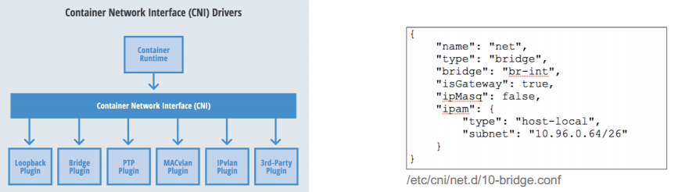
Networking with Kubernetes
Notes:
Move this goal to module 2

Slide 27
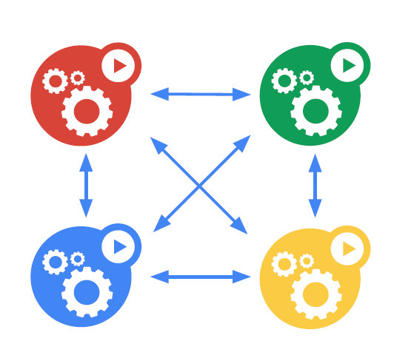
Networking with Kubernetes
IPs are routable
vs docker default private IP
Pods can reach each other without NAT
even across nodes
because every pod its own IP address
No brokering of port numbers
too complex, why bother?
This is a fundamental requirement
all containers can communicate with all other containers without NAT
all nodes can communicate with all containers (and vice-versa) without NAT
the IP that a container sees itself as is the same IP that others see it as
Notes:
Move this goal to module 2

Slide 28
Networking with Kubernetes
On GCE/GKE
GCE Advanced Routes (program the fabric)
https://cloud.google.com/compute/docs/vpc/#routing
“Everything to 10.1.1.0/24, send to this VM”
The container bridge (called cbr0 to differentiate it from docker0) is set up outside of Docker proper.
Plenty of other ways
AWS: Route Tables
Weave
Calico
Flannel
OVS
OpenContrail
Cisco Contiv
Others...
Highly-coupled container-to-container communications
Pod-to-Pod communications
Pod-to-Service communications
External-to-internal communications
Notes:
Move this goal to module 2

Slide 29
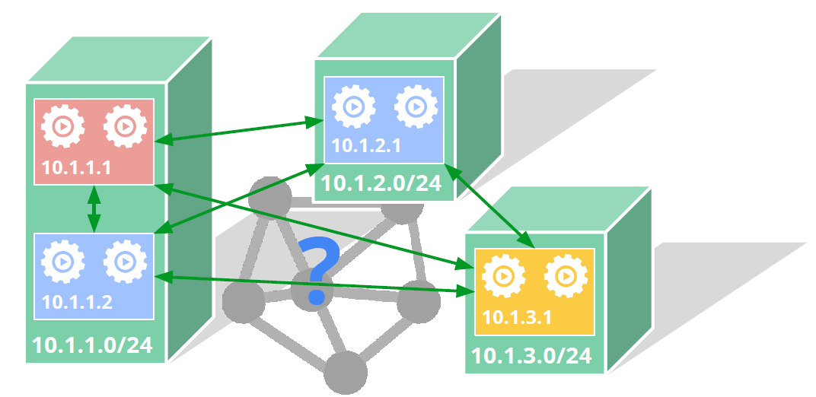
Networking with Kubernetes
Pod
Kubernetes applies IP addresses at the Pod scope
Containers within a Pod share their network namespaces - including their IP address
Containers within a Pod can all reach each other’s ports on localhost
containers within a Pod must coordinate port usage
If your job previously ran in a VM, your VM had an IP and could talk to other VMs in your project. This is the same basic model.
Notes:
Move this goal to module 2

Slide 30
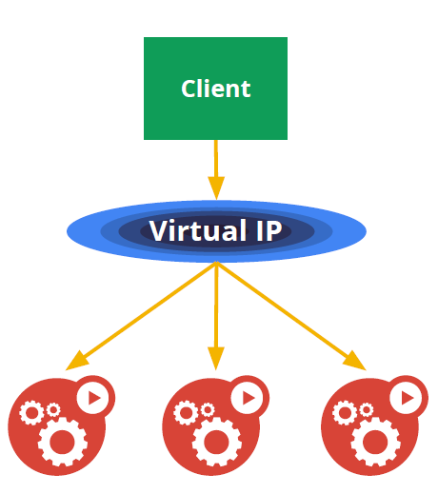
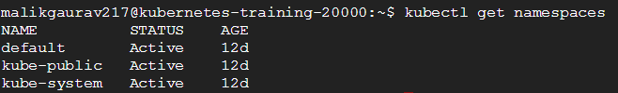
Networking with Kubernetes
Service
The service abstraction provides a way to group pods under a common access policy
implementation of this creates a static virtual IP
Each node runs a kube-proxy process which programs iptables rules to trap access to service IPs and redirect them to the correct back-ends
This provides a highly-available load-balancing solution with low performance overhead by balancing client traffic from a node on that same node.
Notes:
Move this goal to module 2

Slide 31
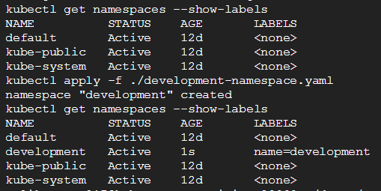
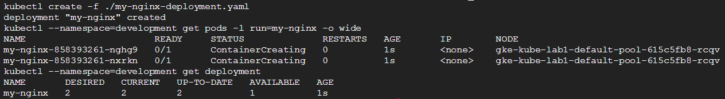
Networking with Kubernetes
Service
-- 1. create namespace “development”
kubectl apply -f ./development-namespace.yaml
--2. create deployment “my-nginx”
kubectl create -f ./my-nginx-deployment.yaml
https://github.com/kube-training/service-network.git
Notes:
Move this goal to module 2

Slide 32
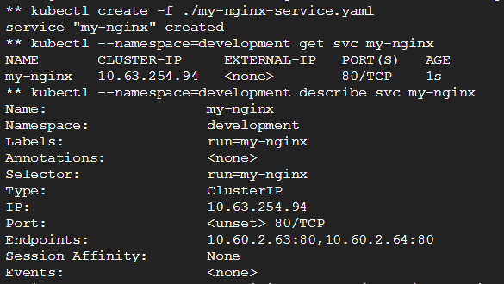
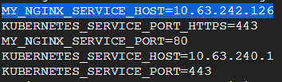
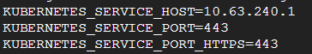
Networking with Kubernetes
Service
-- 3. create service “my-nginx”
kubectl create -f ./my-nginx-service.yaml
You should now be able to curl the nginx Service on 10.63.254.94:80 from any node in your cluster.
--4. Accessing the Service
- Environment variables
kubectl exec my-nginx-858393261-j0rxk -- printenv | grep SERVICE
Note:
there’s no mention of your Service. This is because you created the replicas before the Service.
kubectl --namespace=development scale \ deployment my-nginx --replicas=0;
kubectl --namespace=development scale \ deployment my-nginx --replicas=2;
Notes:
Move this goal to module 2

Slide 33
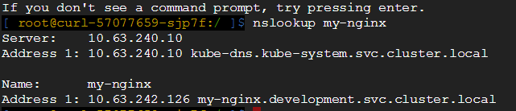
Networking with Kubernetes
- DNS
Kubernetes offers a DNS cluster addon Service that uses skydns to automatically assign dns names to other Services
kubectl get services kube-dns --namespace=kube-system
you can talk to the Service from any pod in your cluster using standard methods
kubectl --namespace=development run curl --image=radial/busyboxplus:curl -i --tty
Start a busybox container, and use wget on the nginx service:
kubectl run busybox --rm -ti --image=busybox /bin/sh
# wget --spider --timeout=1 my-nginx
Notes:
Move this goal to module 2

Slide 34
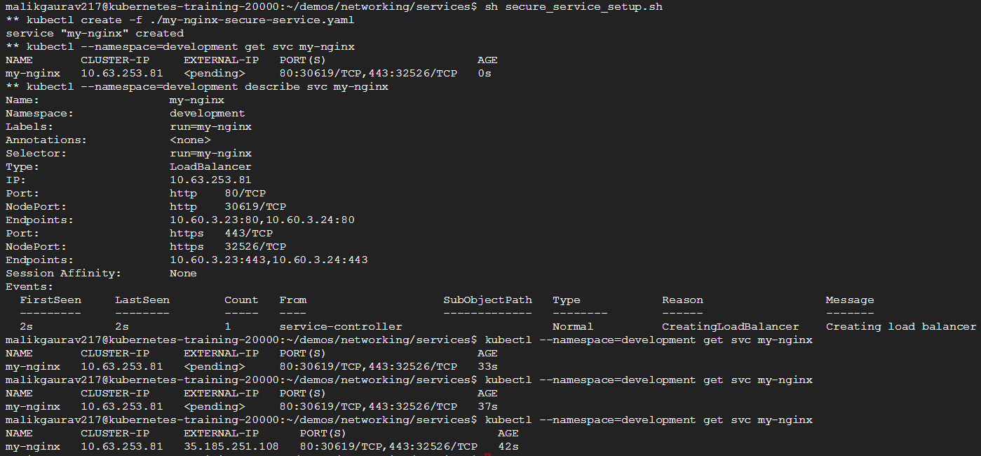
Networking with Kubernetes
--4. Exposing the Service
Kubernetes supports two ways of doing this:
NodePorts
LoadBalancers
Notes:
Move this goal to module 2

Slide 35
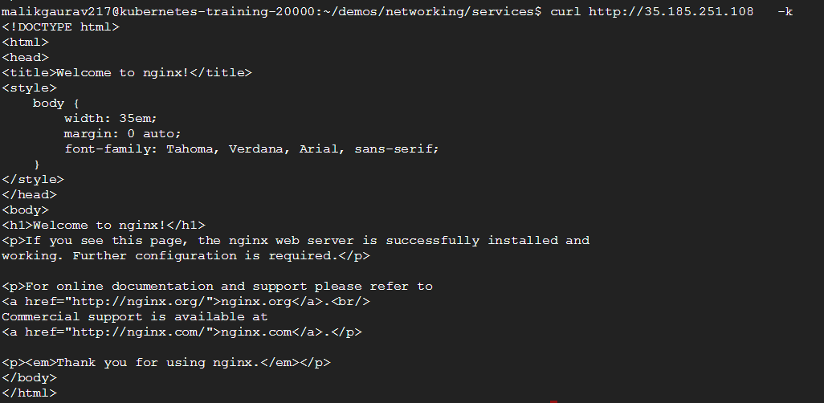
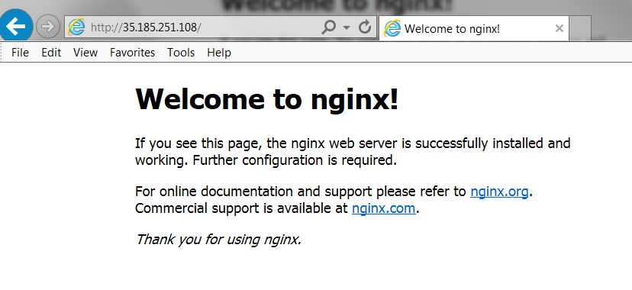
Networking with Kubernetes
Accessing the service
curl http://35.185.251.108 -k
Notes:
Move this goal to module 2

Slide 36
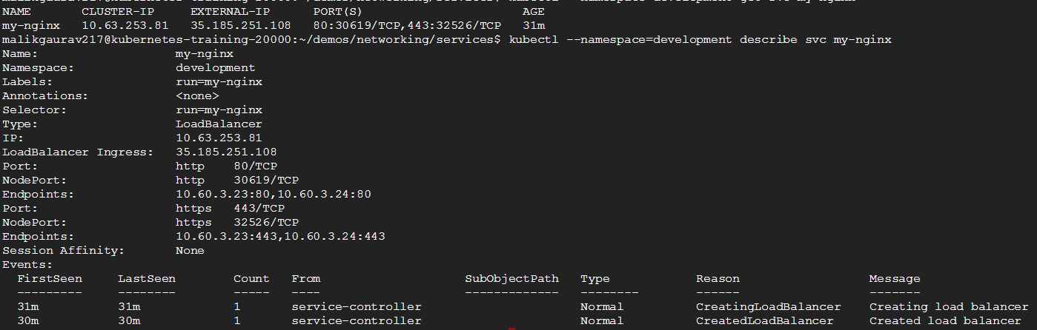
Networking with Kubernetes
kubectl --namespace=development describe svc my-nginx
Notes:
Move this goal to module 2

Slide 37
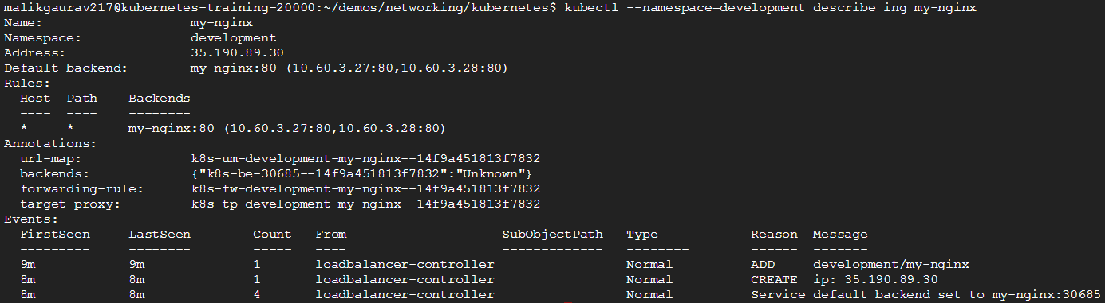
Networking with Kubernetes
An Ingress is a collection of rules that allow inbound connections to reach the cluster services.
Single Service Ingress
Simple fanout
Name based virtual hosting
TLS
Loadbalancing
Ingress
# create Ingress for my-nginx service
kubectl create -f ./my-nginx-ingress.yaml
# describe my-nginx ingress
kubectl --namespace=development describe ing my-nginx
Notes:
Move this goal to module 2

Slide 38


